Slide 1


The Meaning of International Business
Domestic business: a business that acquires all its resources and sells its products or services within a single country.
International business: a business that is primarily based in a single country but acquires some meaningful share of its resources or revenues (or both) from other countries.

Slide 2

Meaning of International Business (cont’d)
Multinational business: one that has a worldwide marketplace from which it buys raw materials, borrows money, and manufactures its products and to which it subsequently sells its products.
Global business: a business that transcends national boundaries and is not committed to a single home country.

Slide 3
Levels of International Business Activity
Lowest Level of International Activity Highest
DOMESTIC
BUSINESS
GLOBAL
BUSINESS
INTERNATIONAL
BUSINESS
MULTINATIONAL
BUSINESS

Slide 4

Terms to Remember:
Market economy:
  Economy based on the private ownership of business and allows market factors such as supply and demand to determine business strategy.
Market system:
  Clusters of countries that engage in high levels of trade with each other.

Slide 5
Managing the Process of Globalization
Exporting: making a product in the firm’s domestic marketplace and selling it in another country.
Importing: bringing a good, service, or capital into the home country from abroad.
Licensing: an arrangement whereby a firm allows another company to use its brand name, trademark, technology, patent, copyright, or other assets in exchange for a royalty based on sales.

Slide 6

Processes of Globalization (cont’d)
Strategic alliance: a cooperative arrangement between two or more firms for mutual gain.
Joint venture: a special type of strategic alliance in which the partners share ownership of a new enterprise.

Slide 7
Processes of Globalization (cont’d)
Direct investment: when a firm headquartered in one country builds or purchases operating facilities or subsidiaries in a foreign country.
Maquiladoras: light assembly plants built in northern Mexico close to the U.S. border that are given special tax breaks by the Mexican government. (see Table 5.1)

Slide 8
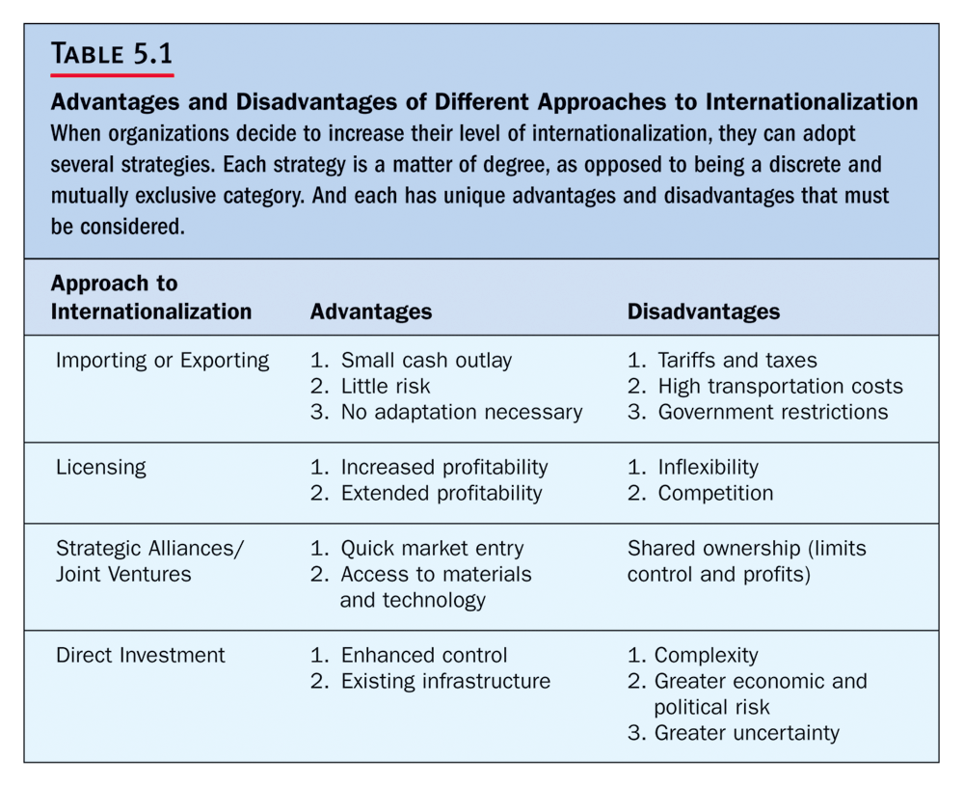

Slide 9
Advantages and Disadvantages of Different Approaches to Internationalization
Approaches to Internationalization: |  | Advantages: |  | Disadvantages:
Importing or Exporting |  | Small cash outlay Little risk No adaptation |  | Tariffs and taxes High transportation costs Government restrictions
Licensing |  | Increased profitability Extended profitability |  | Inflexibility Helps competitors
Strategic Alliance/ Joint Ventures |  | Quick market entry Access to materials and tech. |  | Shared ownership limits Control and profits
Direct investment |  | Enhances control Existing infrastructure |  | Complexity Greater economic and political risk Greater uncertainty

Slide 10
The Three Elements of the Global Economy
1a. Market economy: an economy based on the private ownership of business and allows market factors such as supply and demand to determine business strategy.
1b. Market systems: clusters of countries that engage in high levels of trade with each other. (see Figure 5.2)

Slide 11
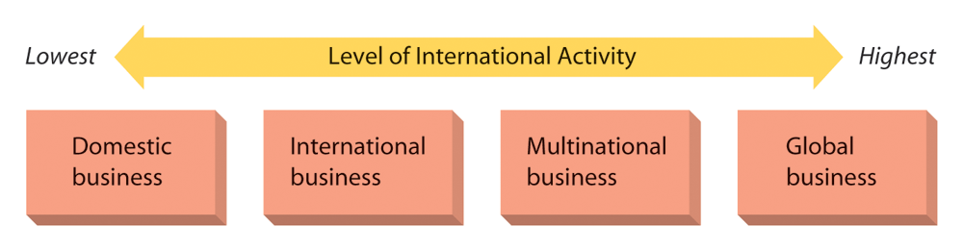
Figure 5.2: The Global Economy

Slide 12

The Three Elements of the
Global Economy (cont’d)
High potential/high growth economies, who have been relatively underdeveloped and immature and, until recently, were characterized by weak industry, weak currency, and relatively poor consumers.
Other economies, exporting countries with property ownership, and the development of infrastructure, and are import players.

Slide 13
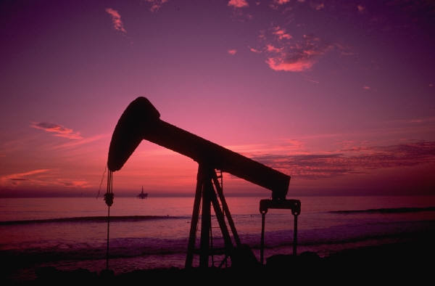
Environmental Challenges of International Management
Economic system: most countries today are moving toward market economies.
(see Figure 5.3)
Natural resources: different countries have various availability of natural resources.
Infrastructure: the schools, hospitals, power plants, railroads, highways, ports, communication systems, air fields, and commercial distribution systems of a country.

Slide 14
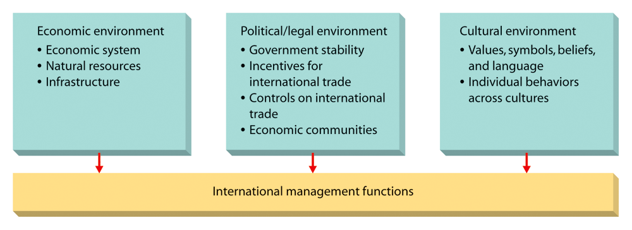
Figure 5.3: Environmental Challenges of International Management

Slide 15

NAFTA
North American Free Trade Agreement:
  Agreement among the U.S., Canada, and Mexico.
European Union (EU):
  First and most important international market system.
Pacific Asia:
  A market system located in Southeast Asia.

Slide 16
The Political Legal Environment
Government stability is important to managers seeking international opportunities. No business wants to set up shop in a foreign market only to see its investment disappear in the face of government nationalization or civil unrest.
Nationalized: taken over by the government.

Slide 17
Controls on International Trade
Tariff: a tax collected on goods shipped across national boundaries.
Quota: a limit on the number or value of goods that can be traded.
Export restraint agreements: accords reached by governments in which countries voluntarily limit the volume or value of goods they export and import from one another.

Slide 18
The Cultural Environment
Individual differences across cultures:
  Social orientation: a person’s beliefs about the relative importance of the individual versus groups to which that person belongs.
  Power orientation: the beliefs that people in a culture hold about the appropriateness of power and authority differences in hierarchies such as business organizations.

Slide 19
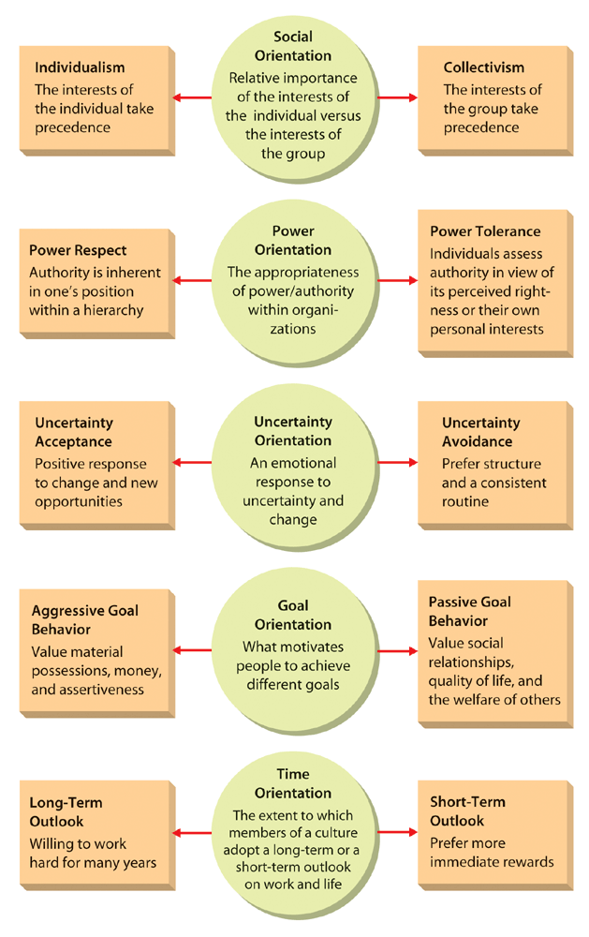
Figure 5.4: Individual Differences
Across Cultures

Slide 20

Differences Across Cultures
Uncertainty orientation: the feeling individuals have regarding uncertain and ambiguous situations.
Goal orientation: the manner in which people are motivated to work toward different kinds of goals.
Time orientation: the extent to which members of a culture adopt a long-term versus a short-term outlook on work, life, and other elements of society.

Slide 21
Globalization and Organizational Size
Multinational corporations transfer capital, technology, human resources, inventory, and information from one market to another, seeking new expansion opportunities.
Medium-size organizations may buy and sell products made abroad and compete with businesses from other countries in their own domestic market.

Slide 22
Small Organizations
Some serve as local suppliers, for example: Local parts suppliers have been successfully selling products to Toyota and Honda plants in the U.S.
Beyond serving as local suppliers, some small businesses also buy and sell products and services abroad.

Slide 23
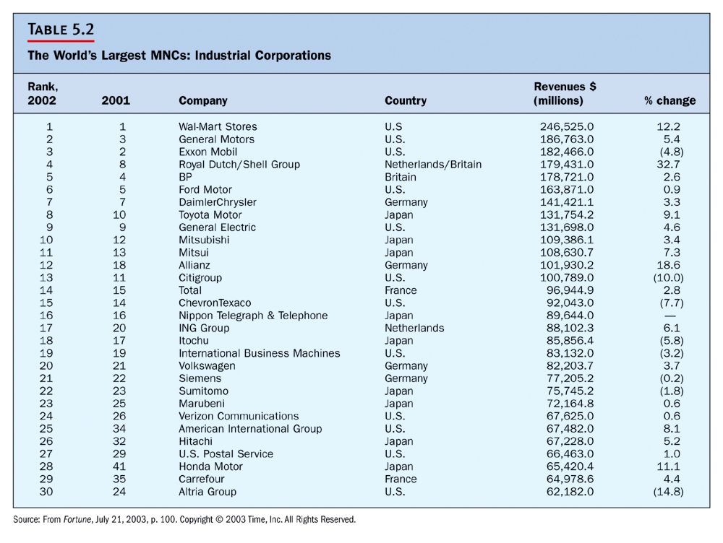

Slide 24
